Slide 1
Microprocessor System Design
Processor Timing
Omid Fatemi
(omid@fatemi.net)

Slide 2
Outline
Machine cycle
Fetch, decode, execute
Processor timing / Bus cycles
Memory / IO read
Memory / IO write

Slide 3
Where is a program stored?
;assume that initially
;ds = 2000, bx = 0023, ax = 351C
;cs = 1000, ip = 0005
mov [bx], al ;8807
hlt ;F4

Slide 4
How does the μP works?
Fetch
Increment Program Counter (CS:IP) by 1
Decode
Execute (if necessary)

Slide 5
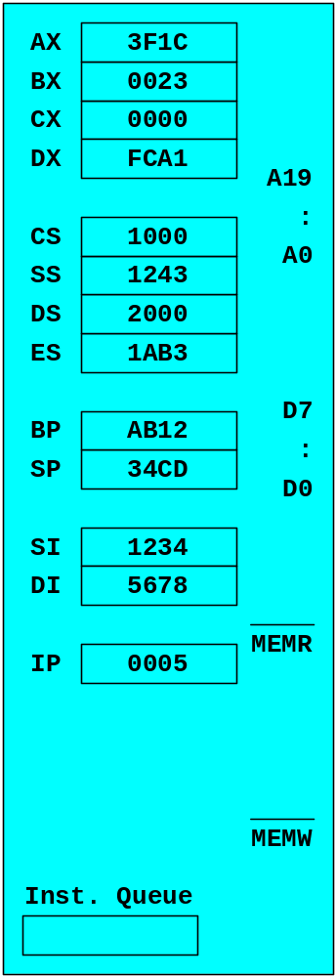
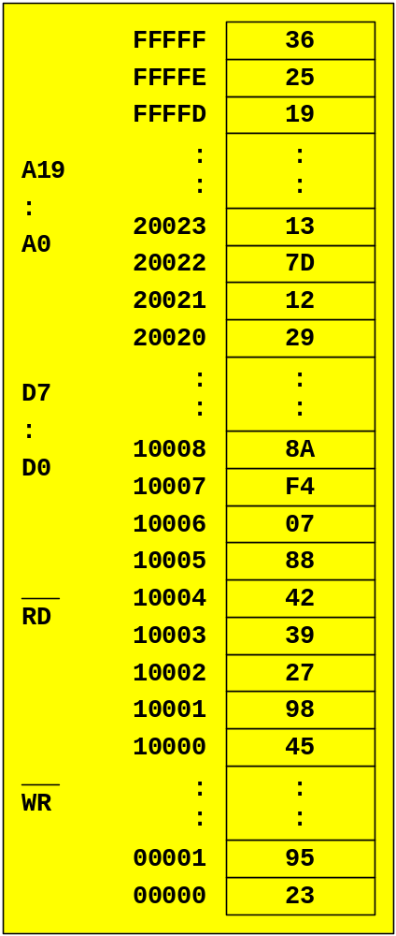
FETCH
CS:IP

Slide 6
FETCH
1000:0005

Slide 7
FETCH
10005

Slide 8
FETCH
10005
LOW
HIGH

Slide 9
FETCH
10005
88
LOW
HIGH

Slide 10
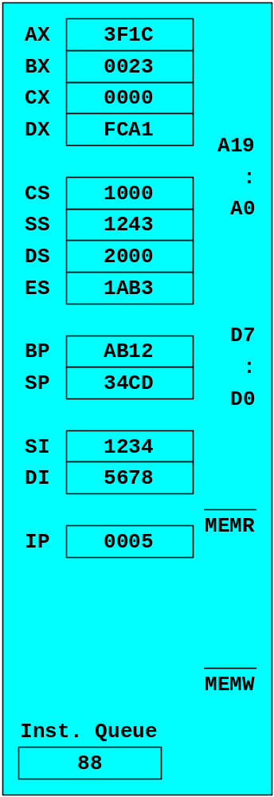
FETCH
10005
88
LOW
HIGH

Slide 11
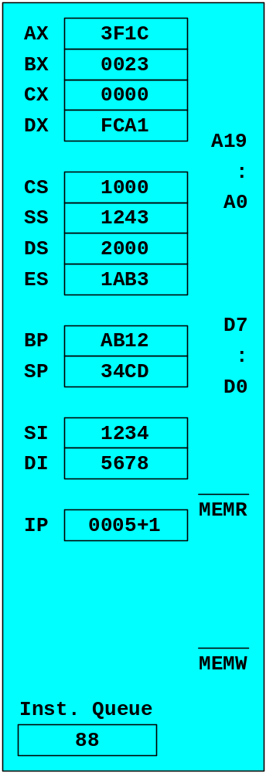
INC. PC

Slide 12

INC. PC

Slide 13
DECODE
mov [bx], ?

Slide 14
FETCH
CS:IP

Slide 15
FETCH
1000:0006

Slide 16
FETCH
10006

Slide 17
FETCH
10006
LOW
HIGH

Slide 18
FETCH
10006
07
LOW
HIGH

Slide 19
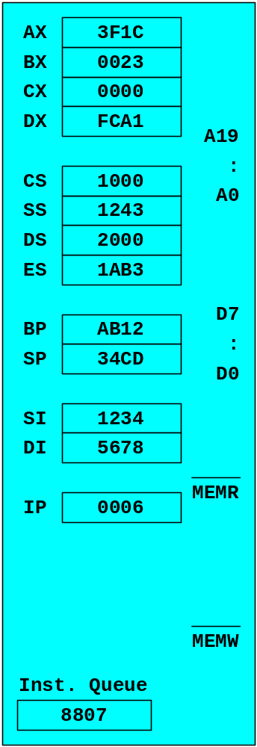
FETCH
10006
07
LOW
HIGH

Slide 20
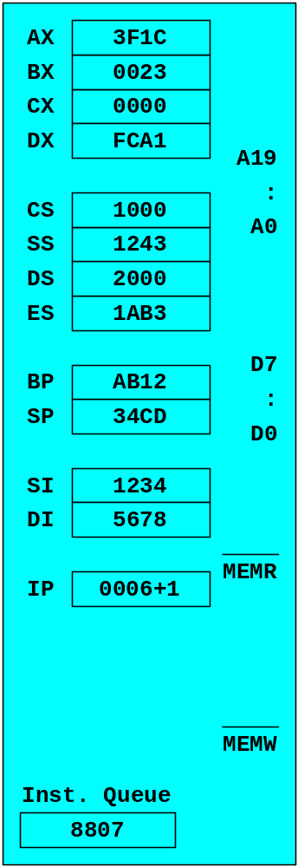
INC. PC

Slide 21
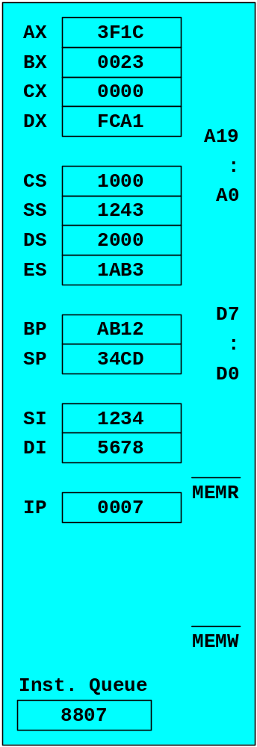
INC. PC

Slide 22
DECODE
mov [bx], al

Slide 23
EXECUTE
mov [bx], al
DS:BX

Slide 24
EXECUTE
mov [bx], al
2000:0023

Slide 25
EXECUTE
mov [bx], al
20023

Slide 26
EXECUTE
mov [bx], al
20023
1C

Slide 27
EXECUTE
mov [bx], al
20023
1C
HIGH
LOW

Slide 28

EXECUTE
mov [bx], al
20023
1C
HIGH
LOW

Slide 29

FETCH
CS:IP

Slide 30
FETCH
1000:0007

Slide 31
FETCH
10007

Slide 32
FETCH
10007
LOW
HIGH

Slide 33
FETCH
10007
F4
LOW
HIGH

Slide 34

FETCH
10007
F4
LOW
HIGH

Slide 35
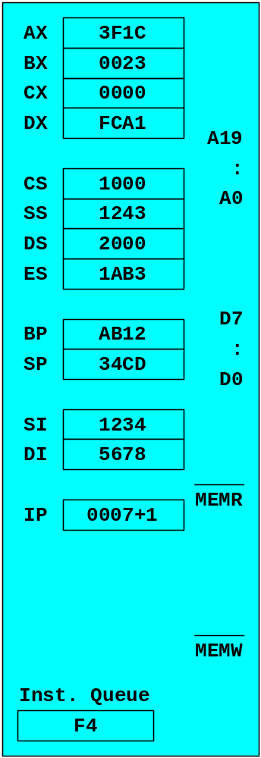
INC. PC
10007
F4
LOW
HIGH

Slide 36

INC. PC
10007
F4
LOW
HIGH

Slide 37
DECODE
10007
F4
LOW
hlt
HIGH

Slide 38
EXECUTE
hlt

Slide 39
Machine Cycle

Slide 40
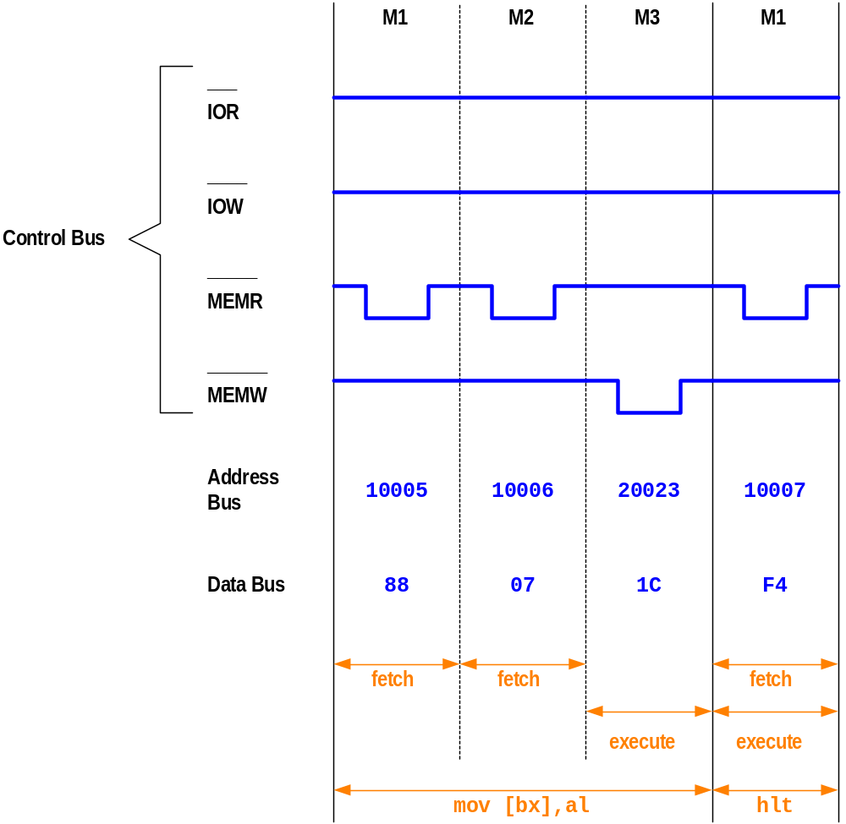
Machine Cycle Timing Diagram

Slide 41
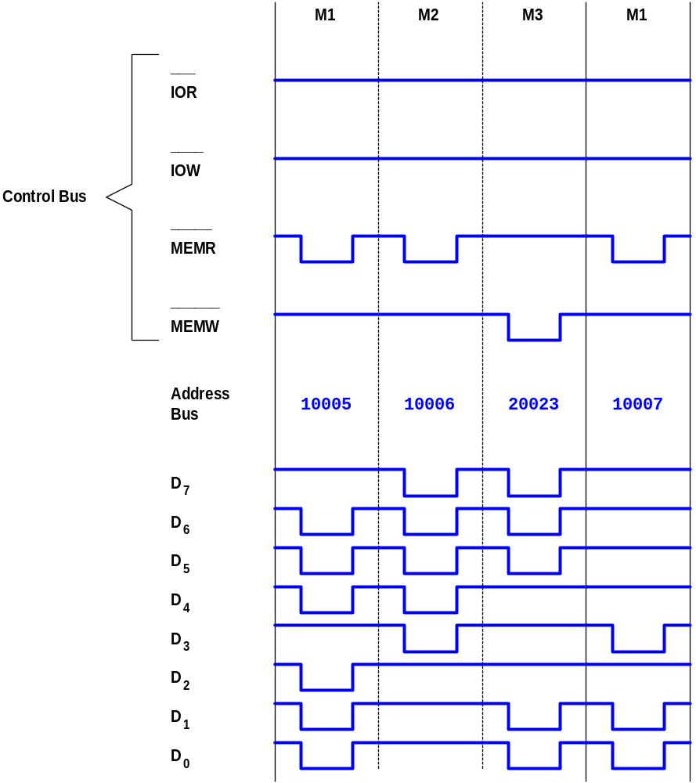

Slide 42
Processor Timing

Slide 43
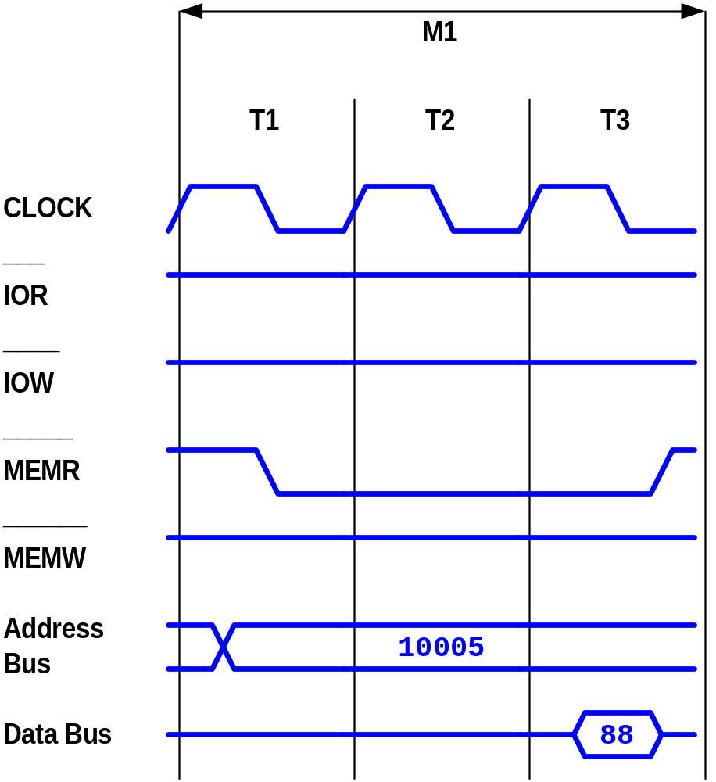
Processor Timing Diagram for the 1st fetch machine cycle (M1) of instruction mov [bx],al

Slide 44
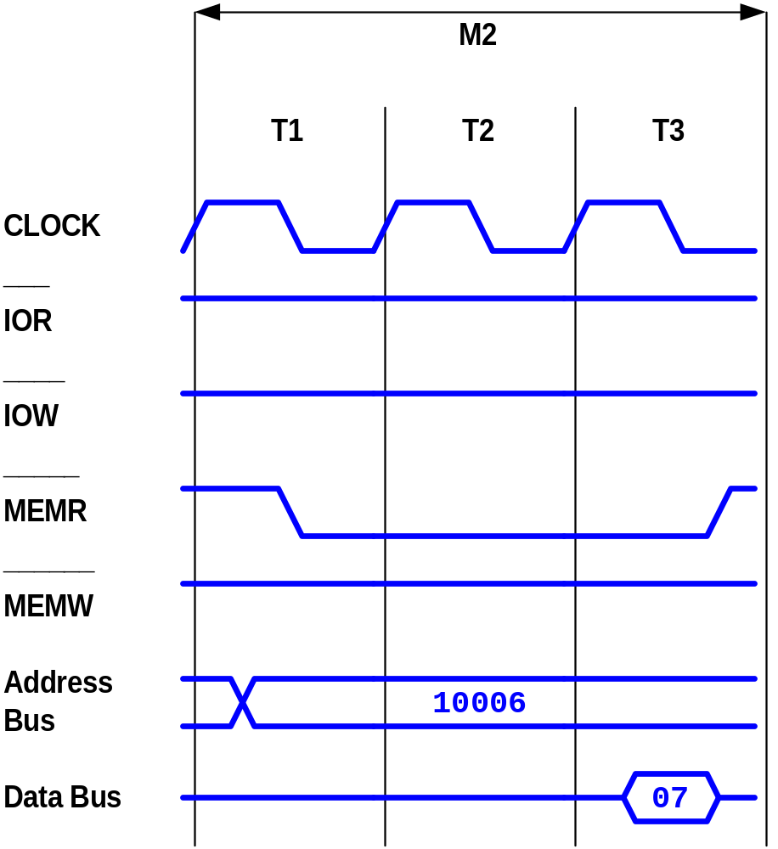
Processor Timing Diagram for the 2nd fetch machine cycle (M1) of instruction mov [bx],al

Slide 45
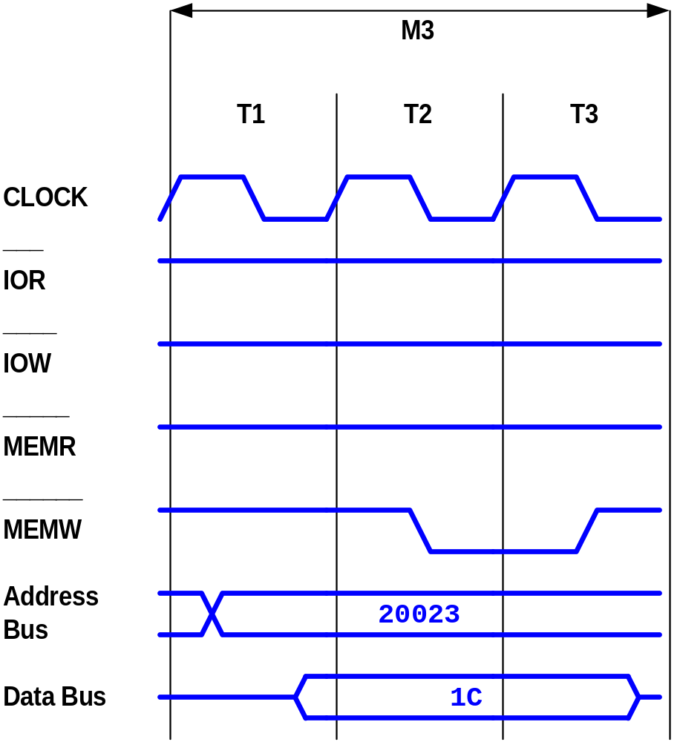
Processor Timing Diagram for the execute machine cycle (M3) of instruction mov [bx], al

Slide 46
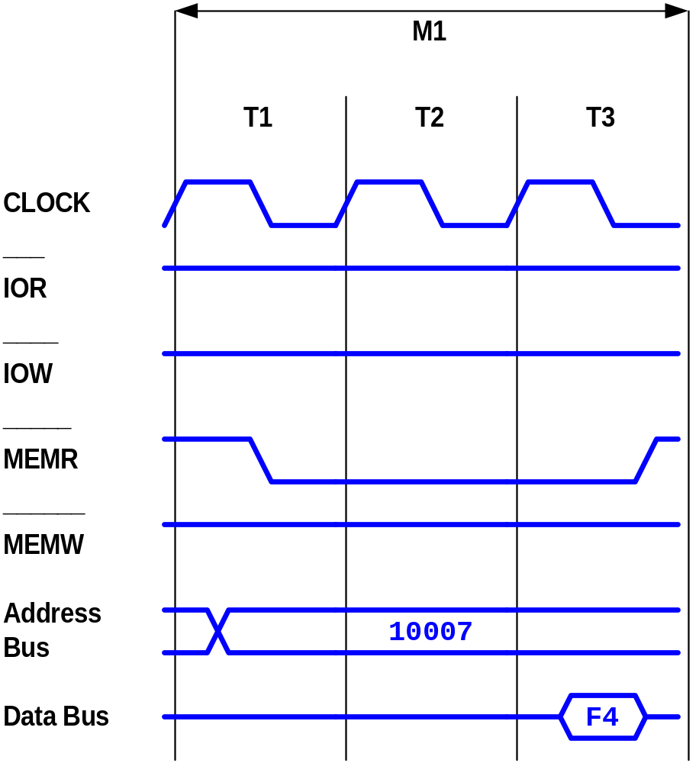
Processor Timing Diagram for the 1st fetch machine cycle (M1) of instruction hlt

Slide 47
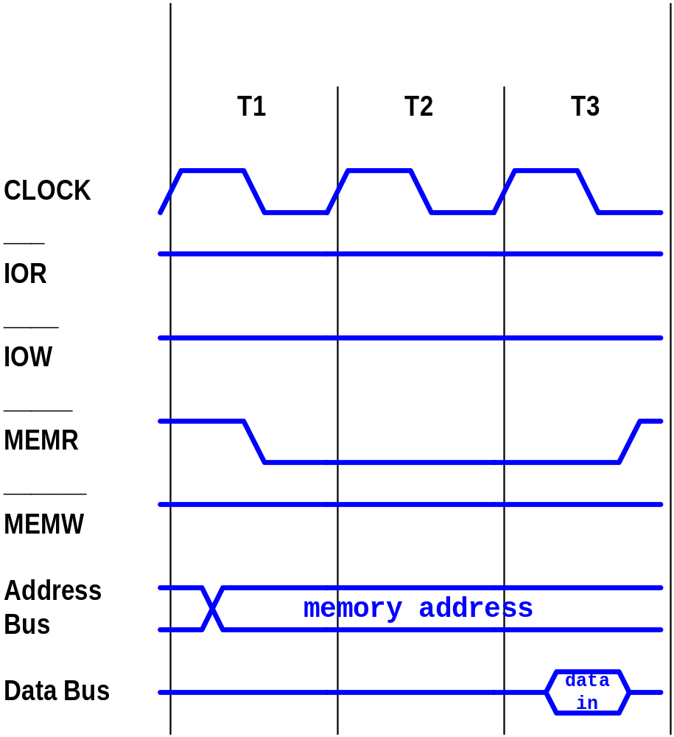
Processor Timing Diagram for any memory read machine cycle

Slide 48
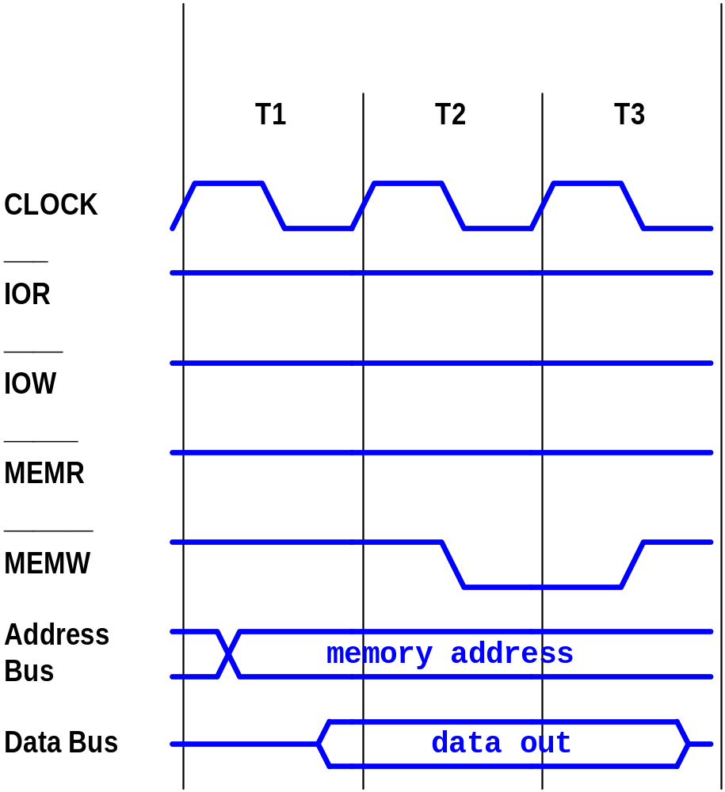
Processor Timing Diagram for any memory write machine cycle

Slide 49
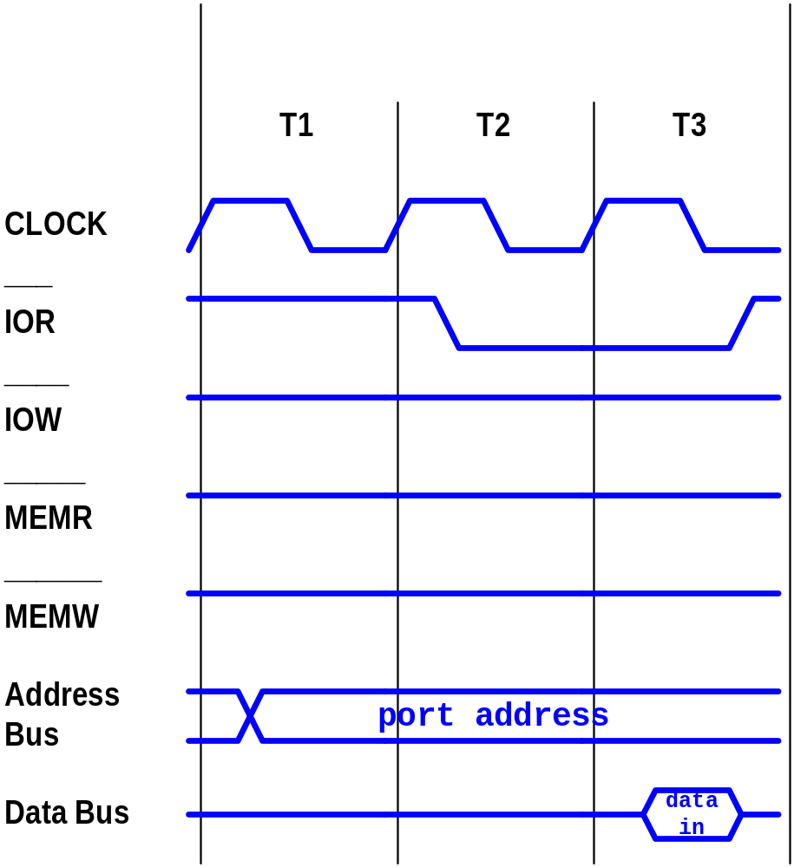
Processor Timing Diagram for any I/O read machine cycle

Slide 50
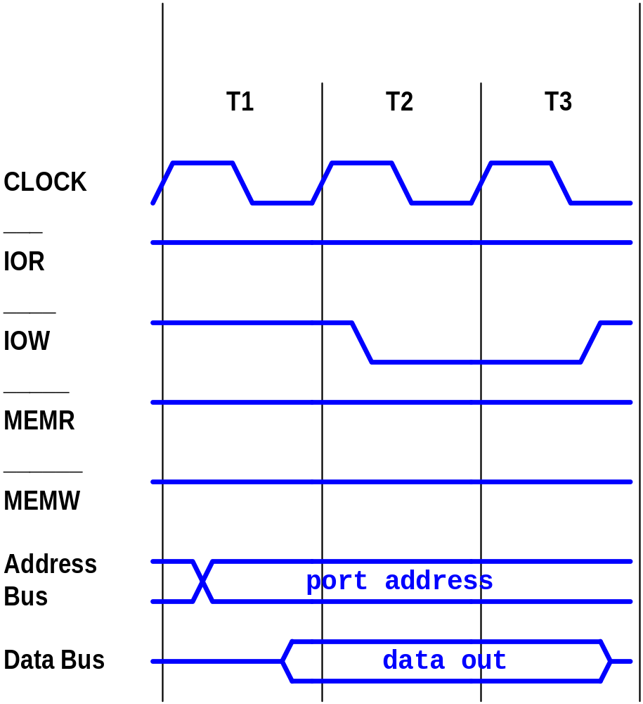
Processor Timing Diagram for any I/O write machine cycle

Slide 51
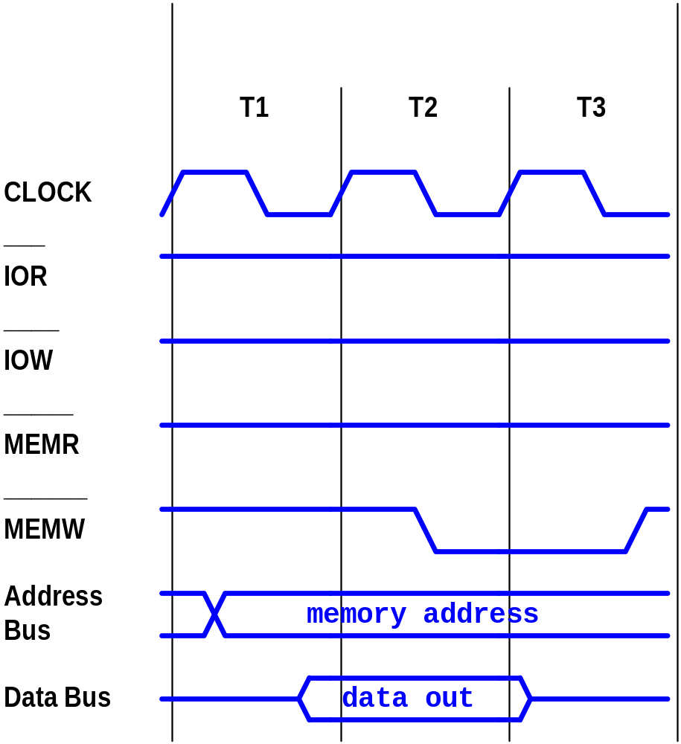
Wrong implementation of
Processor Timing Diagram for memory write cycle

Slide 52
Exercise
Programs.
17, 18, 19, 20.
Page 101.

